Slide 1
Redshift Security

Slide 2
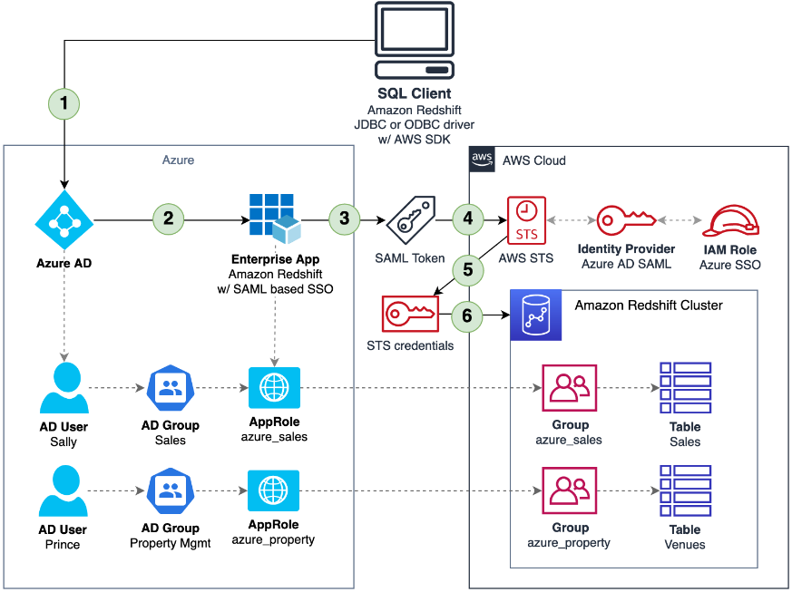
Solution Overview

Slide 3
Logical Steps
You configure a JDBC or ODBC driver in SQL client to use Azure AD federation and use Azure AD login credentials to sign in. Technically, in this step the JDBC or ODBC driver connects to AWS to obtain temporary database credentials for Amazon Redshift. Because this particular request contains a reference to an external IdP, AWS takes the client to Azure for federated authentication using SAML 2.0.
A non-gallery enterprise application is set up to support SAML-based sign-on into Amazon Redshift. It also links Azure AD groups and users to app-specific role names. In this case, Azure AppRoles are used to associate Azure AD groups with Amazon Redshift groups.
The Azure enterprise application queries Azure AD and generates a SAML response, which includes the IAM roles assigned to the user. It also sets additional SAML attributes to indicate assumed AppRoles, which are derived from a user’s Azure group memberships. As an example, Azure user Sally is a member of the Azure group Sales, which is linked to the AppRole azure_sales. The SAML token issued for Sally includes all AppRoles Sally assumes through her Azure group memberships.
The client receives the SAML response.
The SAML assertion goes to the AWS federation endpoint, which invokes the AssumeRoleWithSAML API of AWS STS and generates temporary IAM credentials. These IAM credentials grant permissions for the client to assume temporary membership to any Amazon Redshift permissions group whose names correspond with role claims from the SAML token (as described in Step 3). For Sally as a member of the Sales Azure group, her SAML token presents the azure_sales role claim. Accordingly, the generated AWS STS credentials allow the SQL client application to become a temporary member of the Amazon Redshift permissions group azure_sales.
The Amazon Redshift JDBC or ODBC driver in Sally’s SQL client uses these temporary credentials to connect to the Amazon Redshift cluster and add her to the azure_sales permissions group. Sally is now able to access and operate on Amazon Redshift data according to what is permitted for the azure_sales permissions group.

Slide 4
Steps for implementing the Redshift Security, we need following to be completed
1. AWS SSO (Single Sign On) should be established between IdP(Identity Provider i.e. Azure
AD) and service provider (in our case AWS redshift)
2. Azure Active Directory (AD) groups must be created and users should be assigned to
them.
3. AppRoles should be created and must map with AD groups on Azure side.
4. Groups (DBGroups) should be created in Redshift with the same names as AppRoles.
5. Approles and DBGroups should be mapped to each other in IAM role.
6. IAM policy should be created to give access to the DBGroups in Redshift.

Slide 5
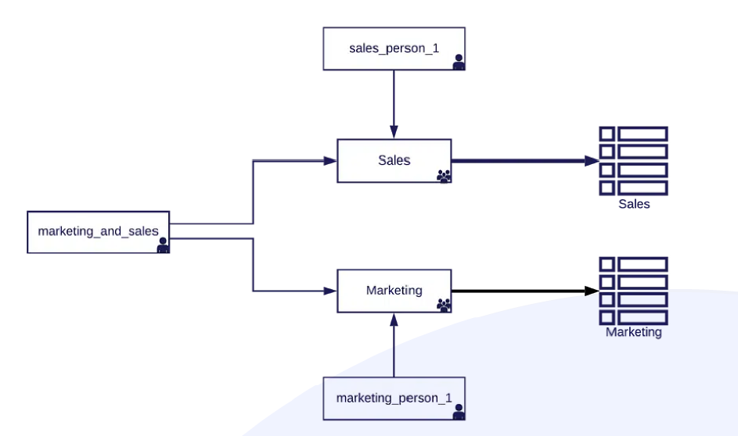
Groups :- can be viewed as roles and can therefore be assigned to users. A user inherits the privileges from the group (or groups) they belong to. This means that, if we have a sales group and a marketing group, we can assign salespeople to the sales group and marketing employees to the marketing group. We can then assign selected “power users” with access to both groups.

Slide 6
Example of managing Redshift access across users, roles and groups
/* Creating the 2 groups */
CREATE GROUP sales;
CREATE GROUP marketing;
/* Creating the 2 schemas with the data */
CREATE SCHEMA red_sales;
CREATE SCHEMA red_marketing;
/*Give sales USAGE rights in schema, and read-only (SELECT) access to the tables within the schema
GRANT USAGE on SCHEMA red_sales to GROUP sales;
GRANT SELECT ON ALL TABLES IN SCHEMA red_sales TO GROUP sales;
/* Give sales USAGE rights in schema, and read-only (SELECT) access to the tables within the schema*/
GRANT USAGE on SCHEMA red_marketing to GROUP marketing;
GRANT SELECT ON ALL TABLES IN SCHEMA red_marketing TO GROUP marketing;

Slide 7
/* Creating a very naive orders table... */
CREATE TABLE demo.public.orders (
order_id varchar(255), order_checksum int, shipping_firstname varchar(50),
shipping_middlename varchar(25), shipping_lastname varchar(50),
shipping_street1 varchar(255), shipping_street2 varchar(255),
shipping_street3 varchar(255), shipping_zipcode varchar(15),
shipping_pob varchar(15), shipping_city varchar(50),
shipping_phone1 varchar(50), shipping_phone2 varchar(50),
shipping_cellular varchar(50), shipping_hours varchar(50),
shipping_comments varchar(255), payer_creditcard varchar(19),
payer_expmonth varchar(2), payer_expyear varchar(4),
payer_rstname varchar(50), payer_middlename varchar(25),
payer_lastname varchar(50), payer_street1 varchar(255),
payer_street2 varchar(255), payer_street3 varchar(255),
payer_zipcode varchar(15), payer_pob varchar(15), payer_city varchar(50),
payer_phone1 varchar(50), payer_phone2 varchar(50), payer_cellular varchar(50),
payer_hours varchar(50), payer_comments varchar(255));
/* Giving the user read-only access */
GRANT SELECT ON demo.public.orders TO sales;
/* And now with the user belonging to sales group, we can do: */
SELECT * FROM demo.public.orders;

Slide 8
Column Level Security in Redshift
/* Revoking the existing SELECT privilege on the entire table */
REVOKE SELECT ON demo.public.orders FROM sales;
/* Granting SELECT privilege specically to all columns except for the forbidden ones */
GRANT SELECT(order_id, order_checksum, shipping_rstname,shipping_middlename, shipping_lastname, shipping_street1,shipping_street2, shipping_street3, shipping_zipcode, shipping_pob,shipping_city, shipping_phone1, shipping_phone2, shipping_cellular,
shipping_hours, shipping_comments, payer_firstname, payer_middlename,payer_lastname, payer_street1, payer_street2, payer_street3, payer_zipcode,payer_pob, payer_city, payer_phone1, payer_phone2, payer_cellular,payer_hours, payer_comments)
ON demo.public.orders TO sales

Slide 9
Row Level Security in Redshift
In this example, we have a table called department_employees, which contains details about the employees in each department (sales & marketing teams):
CREATE TABLE department_employees (
id int,
name varchar(50),
phone varchar(50),
salary smallint,
department varchar(50));
INSERT INTO department_employees VALUES
(1, 'Seller McSeller' , '+1-212-5555555' , 180 , 'sales' ) ,
(2, 'Sir Sell-A-Lot' , '+1-212-5556666' , 240 , 'sales' ) ,
(3, 'Marky McMarket' , '+1-716-5555555' , 210 , 'marketing' ) ,
(4, 'Sir Market-A-Lot' , '+1-716-5556666' , 270 , 'marketing' ) ;

Slide 10
Row Level Security in Redshift
Create a view, which lists all the username and groups, they belong to
CREATE VIEW users_to_groups
AS
SELECT usename AS user_name, groname AS group_name
FROM pg_user, pg_group
WHERE pg_user.usesysid = ANY(pg_group.grolist)
AND pg_group.groname in (SELECT DISTINCT pg_group.groname from pg_group);
Create a view, which list the information according to current user’s access previleges
CREATE VIEW v_department_employees AS
SELECT * FROM department_employees
WHERE department IN (SELECT user_name, group_name FROM users_to_groups WHERE user_name=CURRENT_USER);
/* Granting access to the user in views */
GRANT SELECT ON users_to_groups TO CURRENT_USER;
GRANT SELECT ON v_department_employees TO CURRENT_USER;

